Slide 1
High Performance Outdoor Navigation from Overhead Data using Imitation Learning
Problem statement and
solution proposal

Slide 2
Problem:
One crucial application of autonomous system in today’s world is outdoor navigation. Search for a method to incorporate prior knowledge about the terrain/environment in the form of satellite image, LiDAR scans (basically overhead data). To do away with manually setting weights for each feature, they used imitation learning.They also used MMP (Maximum Margin Planner) to learn optimal weight for features which imitates the expert behaviour and learn cost functions for each state.

Slide 3
Baseline
Experimental analysis of overhead data processing to support long range navigation. [D. Silver, B. Sofman, N. Vandapel, J. A. Bagnell, and A. Stentz]
This paper describes a system for supporting unmanned ground vehicle navigation through the use of heterogeneous overhead data
The proposed approach relies on the geometric and semantic interpretation of heterogeneous data sources to produce traversal cost maps that can be used to generate accurate global paths through an environment
The above described approach was shown to significantly improve the average vehicle speed while decreasing the amount of human intervention required during navigation

Slide 4
Baseline
Maximum Margin Planning [N. Ratliff, J. Bagnell, and M. Zinkevich]
Proposes a method to learn imitation learning of sequential, goal-directed behavior by standard supervised techniques
The method learns mappings from features to cost so an optimal policy in an MDP with these cost mimics the expert’s behavior

Slide 5
Technical Approach
Key Insights to Problem
Maximum margin planning for learning cost function
Introduction
Single Example
Multiple Example
Applied Imitation Learning on Overhead data
Adaptation to different planners
Regressor Choice
Unachievable Example Paths
Alternate Examples

Slide 6
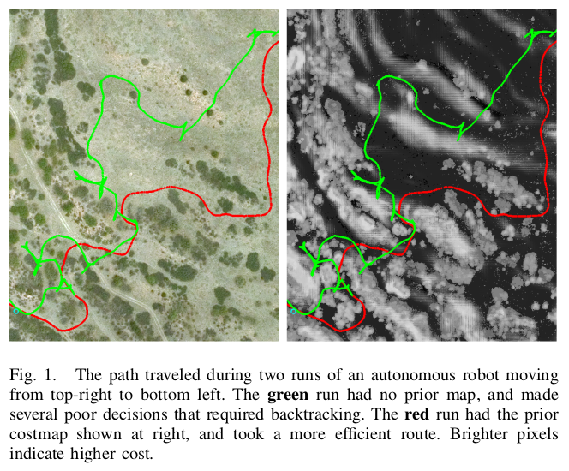
Key Insights to Problem
Observe the improvement in navigation with prior data available.
Setting up cost function manually is difficult owing to different environment could have different cost function, even same environment have different cost function
So, what should we do?
Just find some paths which are favourable by an expert and use that to find perfect cost function

Slide 7
Maximum margin planning for learning cost function - Introduction
As already discussed, MMP provides a feature to cost mapping which make the human expert choice appear optimal
If an example path is provided as the best path between two waypoints, then any acceptable cost function should cost the expert choice as less than or equal to all other paths between those two waypoint
Further, multiple expert provided optimal example increases constraints on cost function for achieving better output

Slide 8
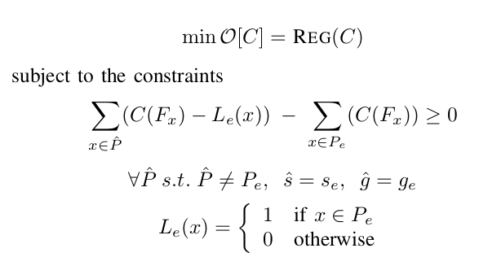
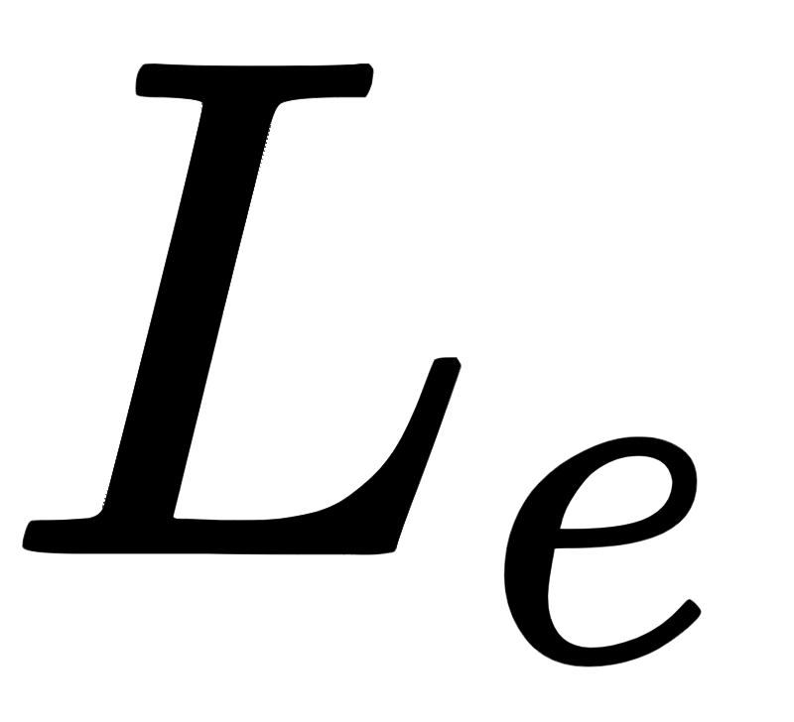
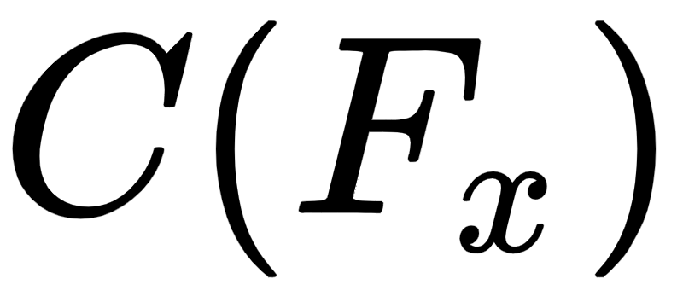
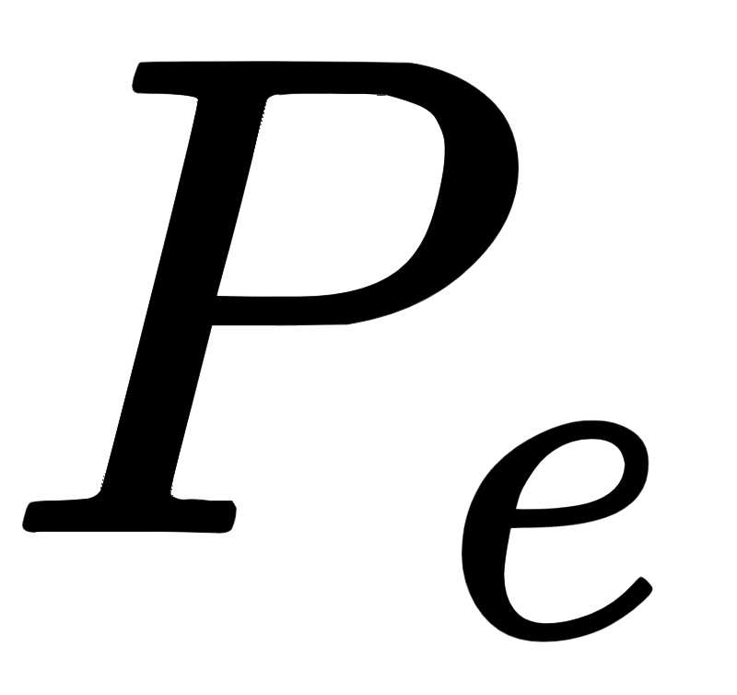
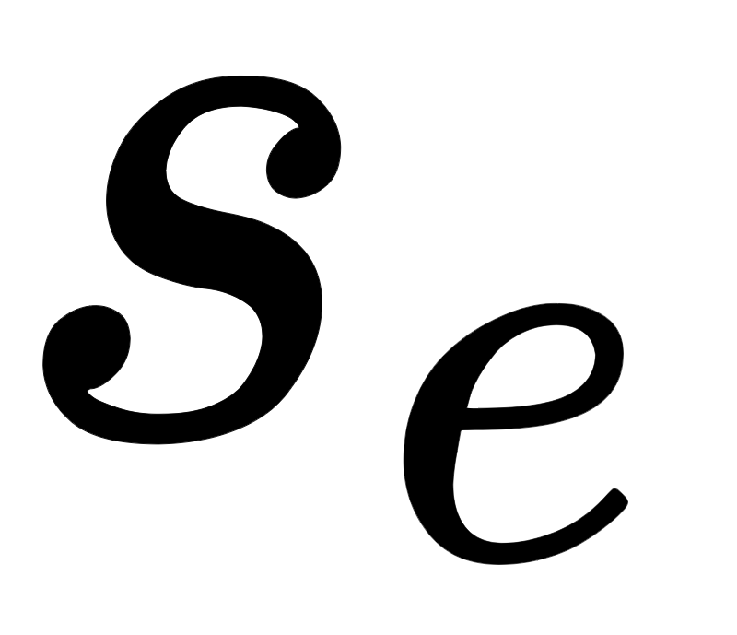
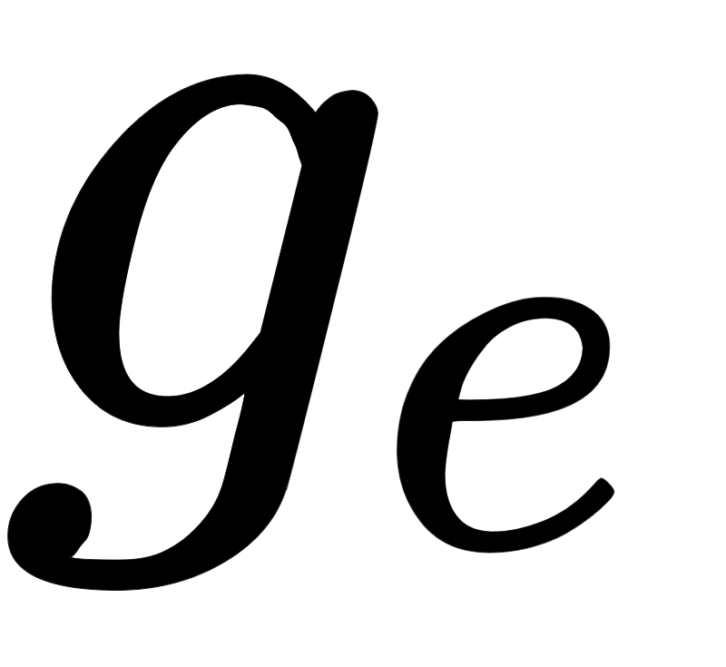
Maximum margin planning for learning cost function - Single Example
Optimal Cost Function can be defined as
Here, REG is a regularization operator
encoding similarity of two paths
Cost of the state x
Lowest cost path between
and
However, there may be infinite number of constraints, so, we will not be able to achieve all constraints, so we add a slack penalty.

Slide 9
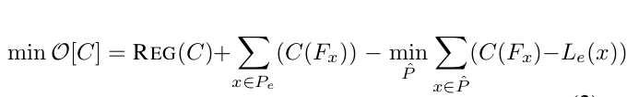

Maximum margin planning for learning cost function - Single Example
Following unconstrained problem that captures constraints as penalties:
Following is the sub-gradient in the space of cost function of the objective:
We can directly apply gradient descent in this space of cost function directly, However that might lead to extreme overfitting.Instead, if we take a small step in a limited set of “directions” using a hypothesis space of functions mapping features to a real number.

Slide 10
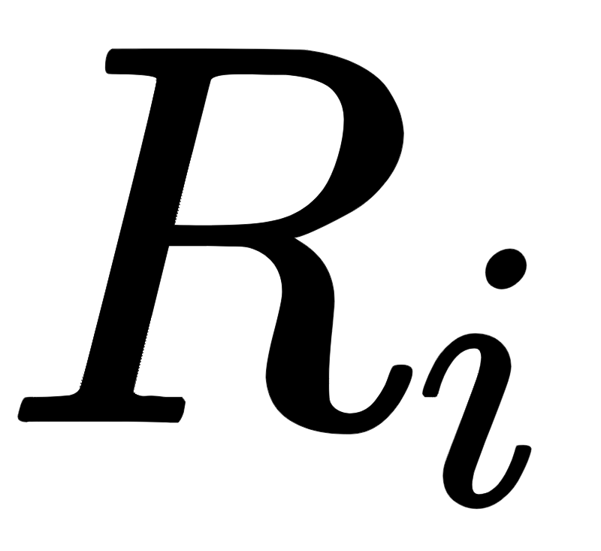
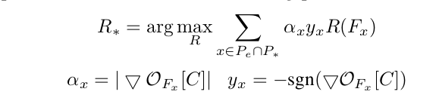
Maximum margin planning for learning cost function - Single Example
The cost function weighted sum of where is defined as
Even we can also apply an exponentiated functional gradient descent where the cost function results in exponential of linearly weighted . Also, this prior as demonstrated by experiments is more natural and effective for problems of outdoor navigation.

Slide 11
Maximum margin planning for learning cost function - Multiple Example
We can’t learn a reasonable planner for each situation with a single expert’s path, hence we need multiple expert’s path
Every expert path will produce its own functional gradient. While learning, these individual gradient can be approximated as batches to minimize training time.
Also, relative weightage of each of the path should be normalised according to their path length, because if it is not done so, longer paths will have greater contribution.

Slide 12
Applied Imitation Learning on Overhead data - Adaptation to different planners
Different planners have different requirements. Consider A* planner, which makes sure that the path must visit every state once. It is really easy to maintain visitation counts. However, for some planar which takes into account the configuration space size, planning could be difficult.
As expanding configuration space might lead to increase in visitation count for adjacent cells. As planar details are really essential to learn proper cost function. Hence, we need to take this in consideration.
Some planner like interpolated A* search, might require visitation count to be non-unit changes to capture the different distances covered in different states.

Slide 13
Applied Imitation Learning on Overhead data - Regressor Choice
Regressor choice have large dependence on performance.
There should be effective balancing between simple regressors and complex regressors, so as to regressor could generalize better but at the same time can learn complex cost function as well.
Weighted combination of linear functions provides a significant decrease in processing time for repeated cost evaluations
MMPBoost algorithm is one such regressor which is a combination of simple and complex regressors. Here algorithm uses linear regressors and then occasionally performing a non-linear regression which is directly added as a feature to the cost function for future linear regressors.

Slide 14
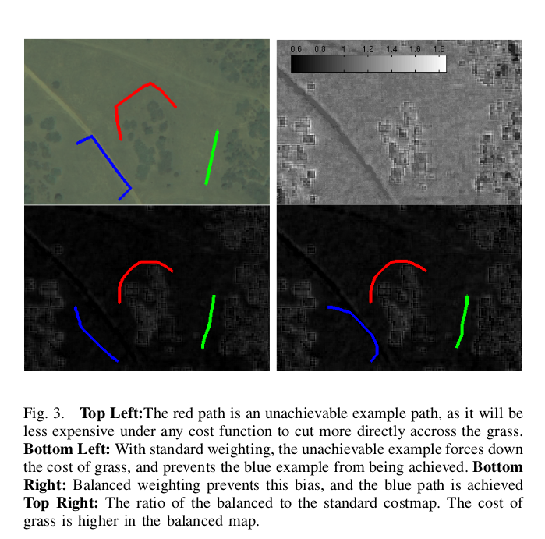
Applied Imitation Learning on Overhead data - Unachievable Example paths
It is often possible to construct expert’s path, such that no consistent cost metric could make expert’s path optimal.
The red example takes a very wide berth around some trees, however, if spacing the path gives the tree is greater than expansion of the planner, then no cost function will consider that planner optimal.
Expert’s path themselves might not be perfect
Also, a limited set of features and planner limitations mean that the path a human truly considers to be optimal may not be achievable using the planning system and features available to learn with.

Slide 15

Applied Imitation Learning on Overhead data - Unachievable Example paths
Now, look at what happens to our functional gradient with an achievable example. This will lead to a bad cost function as optimization will only try to force that path which is not optimal. To counter that, the paper suggests a balances classification on visitation count given slight modification to gradient vector. Here, U’s are the visitation counts.
This modification causes the classifiers to move in the direction of standard one, till it can differ between positive and negative classifier, else it will move towards zero as opposed to moving in the direction of more populous class.

Slide 16
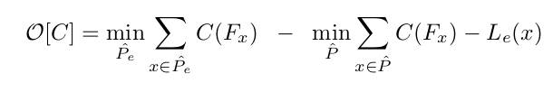
Applied Imitation Learning on Overhead data - Alternate Examples
Human provided example could be slightly error prone owing to noises.
The paper suggests the following objective function with constraint no path is cheaper than the cheapest path that exists completely within a corridor
One downside of this new cost function is that the function is no longer convex, so could converge to very poor cost function. However, as per observations as long as more than a few local minima is present, local minima achieved is quite satisfactory.
More complicated cost functions can also be designed like, varying corridor at different position or a multiple disjoint corridor.

Slide 17
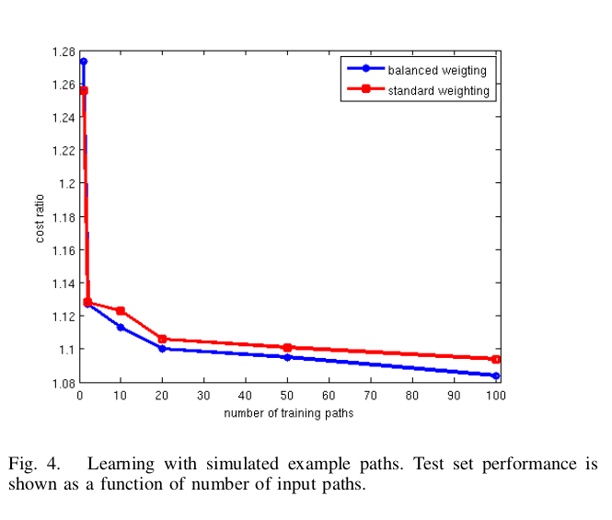
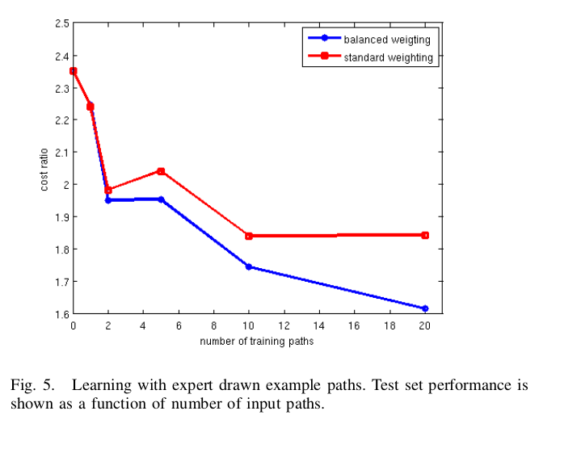
Results - Algorithm Verification
The following graph is generated for simulated examples generated using a known cost function
The following graph is obtained for expert drawn examples

Slide 18
Results - Offline Validation
This experiment was done to compare the costmaps of learned costmaps with engineered ones.
The map was produced by performing a supervised classification of the satellite imagery of 60 sq km area.
The validation cost ratio was 2.23 with engineered map and 1.63 with learned map.

Slide 19
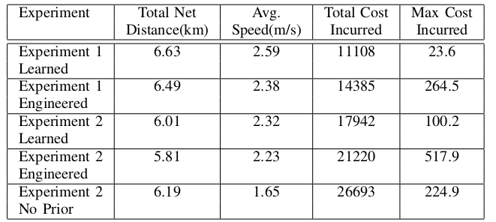
Results - Online Validation
This part tests the learning system on actual autonomous navigation which is done by a six wheeled, skid steer autonomous vehicle.
The test involves traversing a series of courses, with each course defined as a set of widely spaced waypoints.
Improvement of 5% and 10% levels observed in average cost and average speed respectively.
During these experiments, the same course was run multiple times, varying only the prior cost map given to the vehicle. Each run was then scored according to the total cost incurred by the vehicle according to its onboard perception system.

Slide 20
Improvements
The current method presented only increases efficiency for static environments, no consideration is given for dynamic changes in environment that happens over time, for that we can use modular approach by breaking the problem into number of subproblems and then solving them individually. We could deep learning techniques for identifying the problems and engineer solution for each sub problems individually.
The paper deals with problem in 2D domain. However, with new sensors and detector like kinects, which can provide 3D data, more sophisticated cost functions could be learnt and performance could be enhanced. This advancement could be real help for automating systems like drones etc.
This method could easily increase performance of an agent in any environment, till the dynamic changes in environment is not high rather than being limited to outdoor navigation.

